Slide 1
How to use naloxone
Training for Community members

Slide 2
Educational objectives
At the conclusion of this presentation, participants will be better able to:
Explain the problem of opioid addiction
Explain how naloxone (Narcan) works when administered to a person who has overdosed
Recognize the signs of an opioid overdose
Properly administer naloxone (Narcan) in the event of an overdose

Slide 3
National Opioid Statistics
According to the CDC, opioids (including prescription opioids and heroin) killed more than 33,000 people in 2015, more than any year on record (Roughly 1 every 15 minutes)
Nearly half of all opioid overdose deaths involve a prescription opioid (CDC)
In most countries, the use of opioid prescriptions is limited to acute hospitalization and trauma, such as burns, surgery, childbirth and end-of-life care, including patients with cancer and terminal illnesses (CDC)

Slide 4
Local Opioid Statistics
Cass County Overdose Deaths
2016
48 drug-related deaths
31 opioid deaths
17 methamphetamine deaths
2017
33 drug-related deaths
17 opioid deaths
13 methamphetamine deaths
2018 – some still pending
28 drug-related deaths
12 opioid deaths
14 methamphetamine deaths

Slide 5
Why are people dying?
Too much heroin or any opioid causes people to become very sleepy
Their breathing becomes slower and more shallow
Leads to low oxygen levels which causes damage to the heart and brain
Eventually, the heart slows down and stops

Slide 7
North Dakota law
The Good Samaritan Law was passed to encourage friends, family members, and bystanders to call 911 in the event of an overdose.
In order to be immune from prosecution, you need to:
Seek emergency help - Call 911
Remain onsite until assistance arrives
Cooperate with responding personnel giving emergency medical treatment
The Law provides protection from prosecution for the individual experiencing a drug-related overdose and those seeking the emergency medical assistance.
North Dakota Century Code 19-03.1-23.4
Learn more at Dose of Reality Fargo
http://doseofrealityfargo.com/

Slide 8
North Dakota law
According to ND Law, any individual (family, friends, community member) is protected from civil or criminal liability for giving naloxone for a suspected opioid overdose.
An individual who prescribes, distributes, dispenses, receives, possesses, or administers an opioid antagonist as authorized under this section is immune from civil and criminal liability for such action. A health care professional who prescribes, distributes, or dispenses an opioid antagonist as authorized under this section is not subject to professional discipline for such action. This section does not expand the scope of practice of a health care professional. Immunity from liability or discipline Page No. 17 under this subsection does not apply if the individual's actions constitute recklessness, gross negligence, or intentional misconduct.
North Dakota Century Code 23-01-42

Slide 9
Naloxone availability
Fargo Fire and FM Ambulance
Fargo, West Fargo, Cass County Sheriff’s Office and NDSU Police Departments
Fargo Cass Public Health Harm Reduction Center
Participating pharmacies
Fargo Cass Public Health (grant-funded)

Slide 10
Naloxone is effective when…
Naloxone will have no effect when…
The overdose is due to usage of:
Alcohol
Benzodiazepines (Valium, ativan, xanax, klonopin, ambien)
Antidepressants (Paxil, prozac, lexapro, Wellbutrin)
Other mental health medications
Although you may not know what the overdose is from, it may be beneficial to administer naloxone. If opioids have been taken with a combination of other drugs the naloxone will negate the opioid effects and could save a life
The overdose is due to usage of:
Heroin
Morphine
Hydromorphone (Dilaudid)
Oxycodone (Oxycontin, Percocet)
Hydrocodone( Norco, Vicodin)
Fentanyl
Buprenorphine
Codeine
Methadone

Slide 11
Notes:
The naloxone takes the place of the opioid in the brain to prevent the effect of the opioid

Slide 12
How will the victim react?
When naloxone is used, the person will likely develop symptoms like vomiting, sweating and shortness of breath
These are essentially symptoms of withdrawal from the opioid and not unexpected
A person can have different behaviors and emotions upon waking up from an opioid overdose
Confused
Agitated
Stay very sedated but breathing
Anger
Embarrassment
Frustration
Sadness
You cannot harm someone by administering naloxone. In many cases, you can save their life

Slide 13
What does an overdose look like?
When you find someone who you think has overdosed, look for the signs:
Slow or shallow breathing
Gasping for air when sleeping
Pale or bluish skin
Slow heartbeat, low blood pressure
Won’t wake up or respond (sternal rub)
Small pupils
Call 911!

Slide 14
Types of administration
Naloxone can be administered various ways:
IV when under the care of medical providers
Nasal spray
Auto-injector
Intramuscular

Slide 15
PRIOR TO NALOXONE Administration
Assess scene – make sure you are safe
Attempt to wake the person by yelling or shaking them
Call 911
Put on gloves
Provide 2 rescue breaths using mask or rescue breathing aid – you don’t know how long they have been laying there

Slide 16
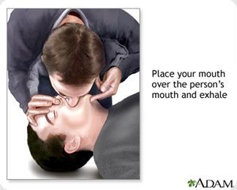
Rescue breaths
One hand on chin, tilt head back, pinch nose closed
Make seal over mouth, breathe into mouth
1 breath every 5 seconds
Chest should rise, not stomach (if stomach rises, readjust)

Slide 18
IM (intra-muscular) ADMINISTRATION

Slide 19
Prepare the naloxone
Attach a needle to the syringe (if not packaged together)
Insert the needle into the vial through the rubber center
The vial should be upside down and the needle below the liquid line of the medication
Pull the plunger of the syringe back while keeping the tip of the needle in the liquid inside the vial

Slide 20
Administer naloxone
Expose the skin of the upper arm or thigh (If you cannot expose the skin, it is acceptable to push the needle through a layer of clothing)
Push the needle straight into the skin and inject the medication
Remove the needle and place in a safe container or give to the EMS
Check the person’s breathing and provide rescue breath every 5 seconds while waiting for the effects of the naloxone

Slide 21
Administer naloxone
If there is no improvement in the patient condition after 2 minutes, administer a second dose of naloxone following steps 1-4
Provide rescue breaths throughout the repeated administration of naloxone – every 5 seconds
If the patient wakes up, do not interfere with their actions
Stay with the patient until help arrives

Slide 22
Evzio auto-injector
Naloxone administration

Slide 23
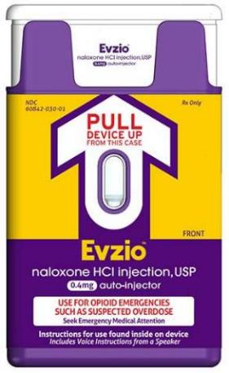
Evzio
Similar to an EPI-Pen or AED
Available by prescription
Cost is high, around $3,500-$4,800

Slide 24
Intranasally – atomizer
Naloxone administration

Slide 25
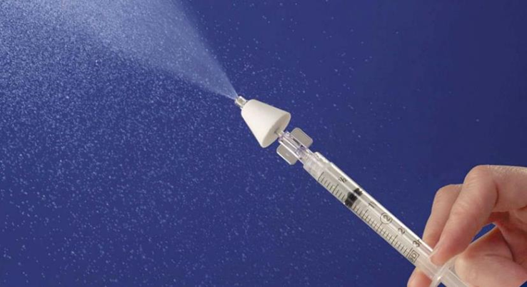
Nasal administration – Atomizer
Attach the medication vial to the syringe
Attach the atomizer to the syringe
Place the atomizer snuggly against the nostril opening
Briskly push the medication vial into the syringe, dispensing ½ of the medication into one nostril and the other half into the other nostril, dispensing 1mL into each nostril
Repeat with another dose after 2 minutes if there is little or no response

Slide 26
Narcan® Nasal Product
Narcan® Administration

Slide 27
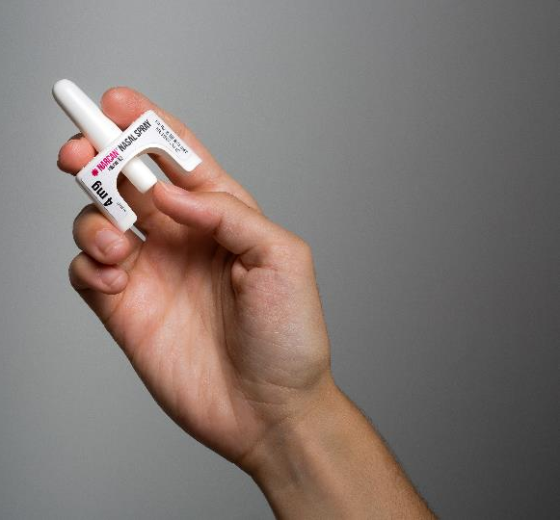
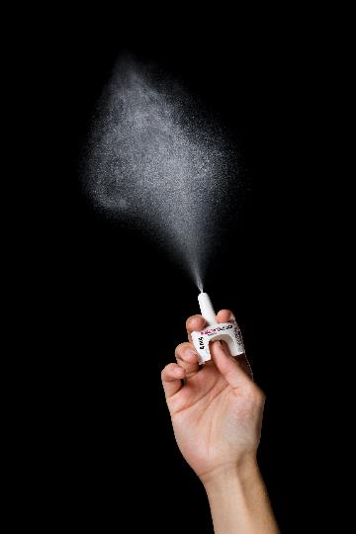
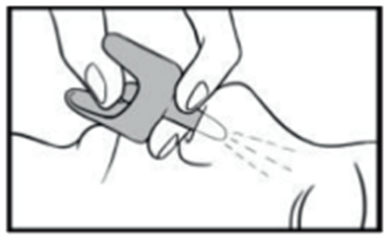
Administer narcan®
Lay person on their back
Remove from box. Peel back tab with circle to open
Hold with your thumb on bottom of plunger and your first and middle fingers on either side of the nozzle
Tilt person’s head back
Insert tip of nozzle into one nostril until your fingers on either side of nozzle are against bottom of person’s nose
Press plunger firmly to give dose and remove from nostril after giving dose
Administer another dose in same fashion if there is little or no response after 2 minutes
Continue rescue breathing every 5 seconds between doses

Slide 28
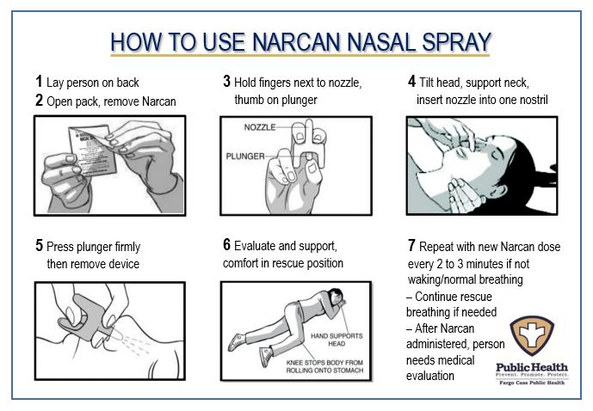

Slide 29
Medication storage
Naloxone should be kept at room temperature
Do not let it freeze in your car
It should be protected from light
The naloxone shelf life is 2 years

Slide 30
Naloxone Administration Trainings available
To schedule a one hour Naloxone Administration Training for your group, contact:
Melissa Markegard
Fargo Cass Public Health
mmarkegard@FargoND.gov
701.476.4083

